Slide 1
OFDM Simulation
方宣翔

Slide 2
Handwriting report
AWGN channel

Slide 3
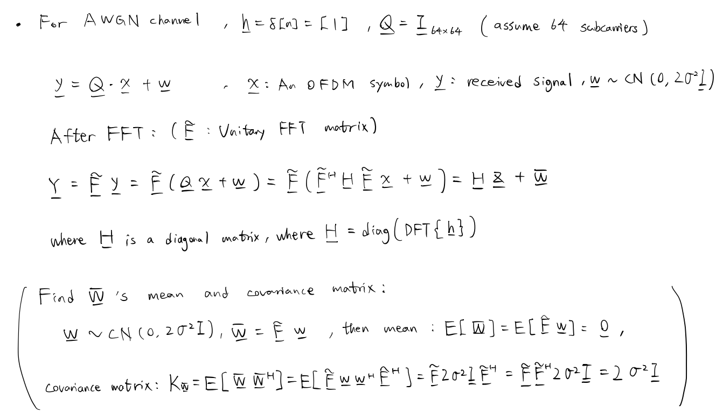

Slide 4
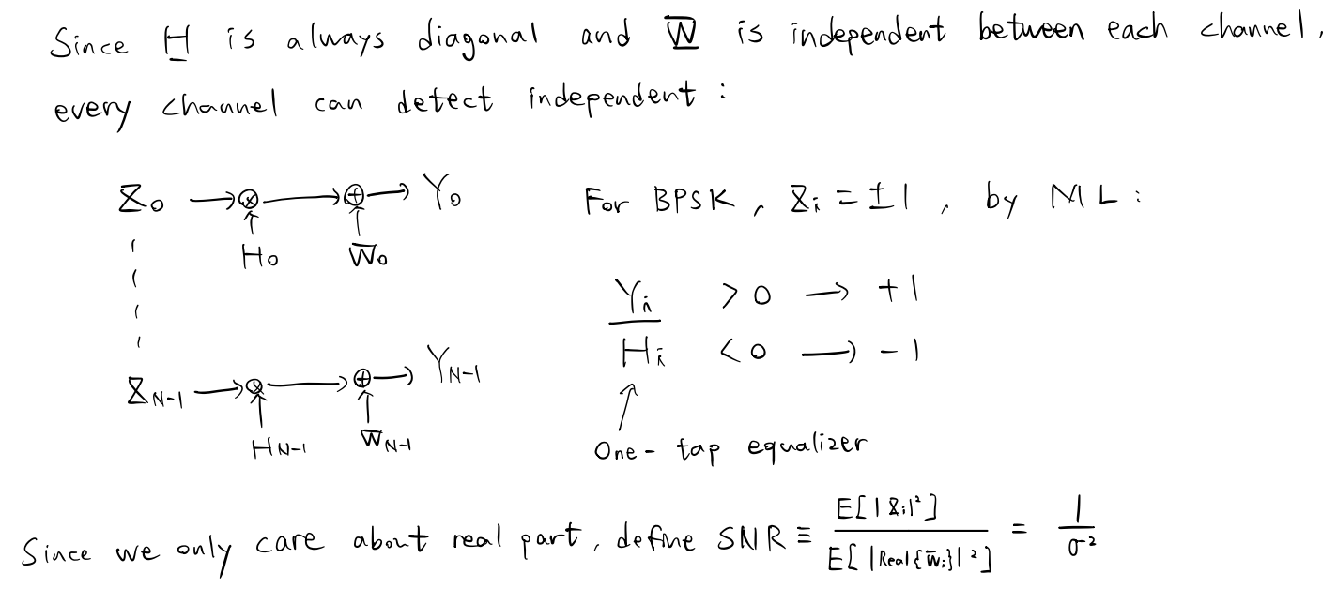

Slide 5
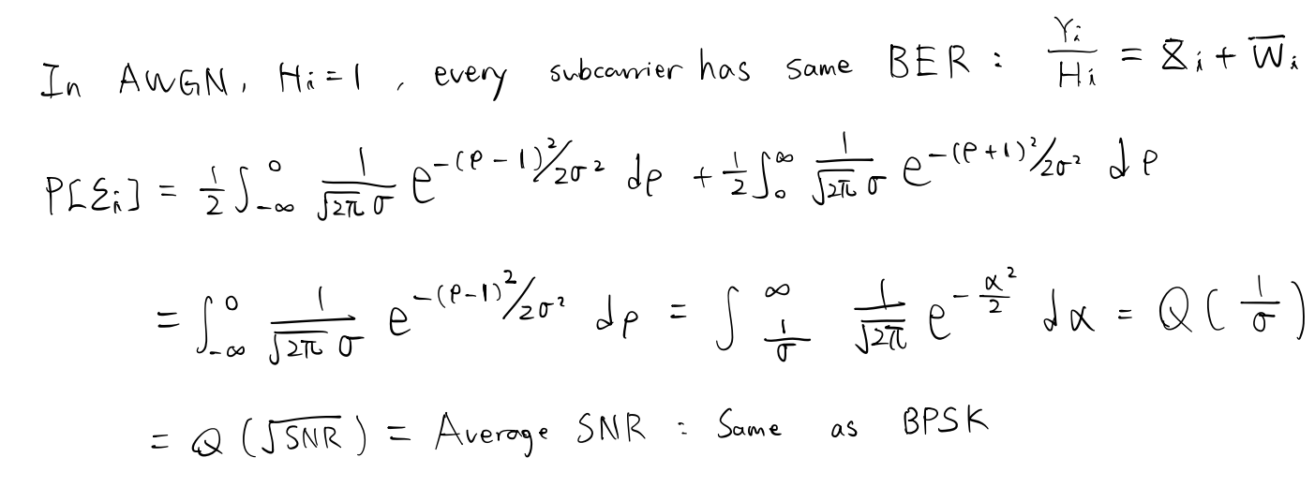

Slide 6
Simulation result
AWGN channel

Slide 7
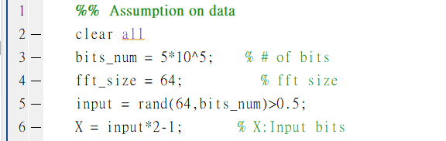
Assumption on OFDM system
Number of bits: 5*10^5
Bits: +-1.
FFT size: 64
Matlab code:

Slide 8
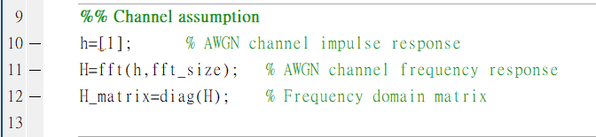
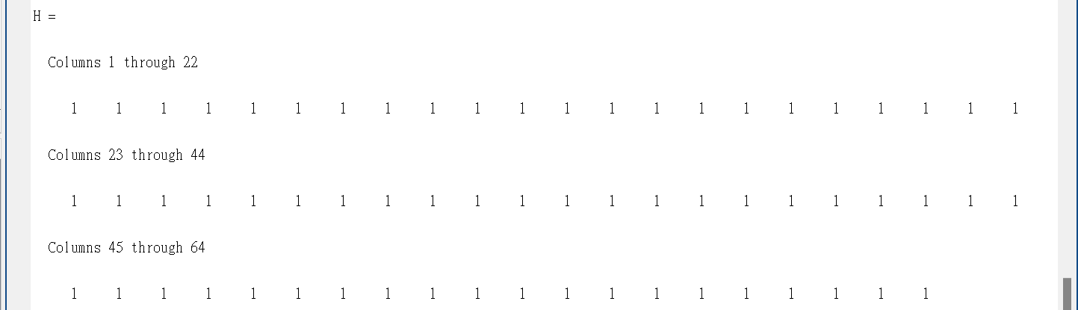

AWGN channel
Matlab code:
$H:$

Slide 9
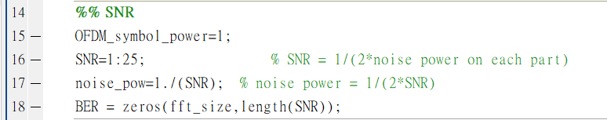
SNR
Assumption on SNR: 1:25 (Linear scale)
Matlab code:

Slide 10
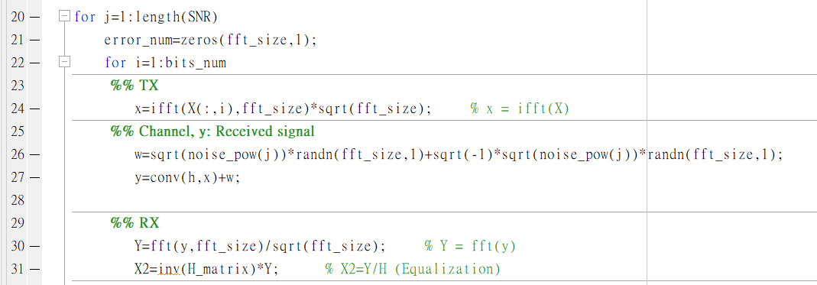
Modulation and demodulation

Slide 11
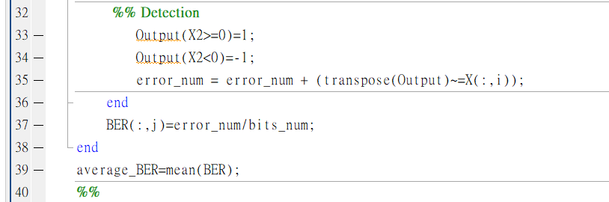
Detection

Slide 12
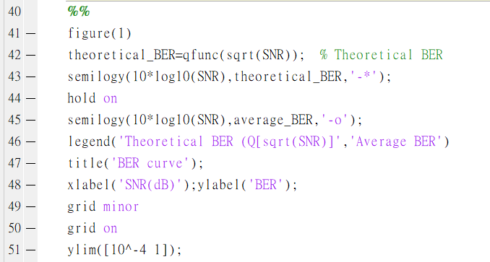
Average BER curve

Slide 14
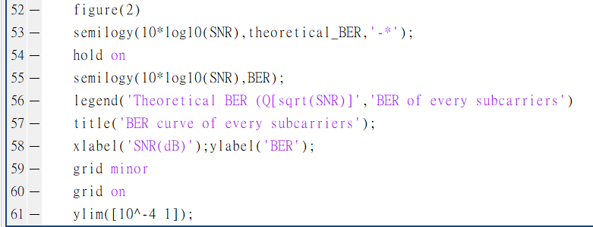
BER curve of each channel

